Slide 1
Data Capstone 1
Eric Huynh
April 2 Cohort

Slide 2
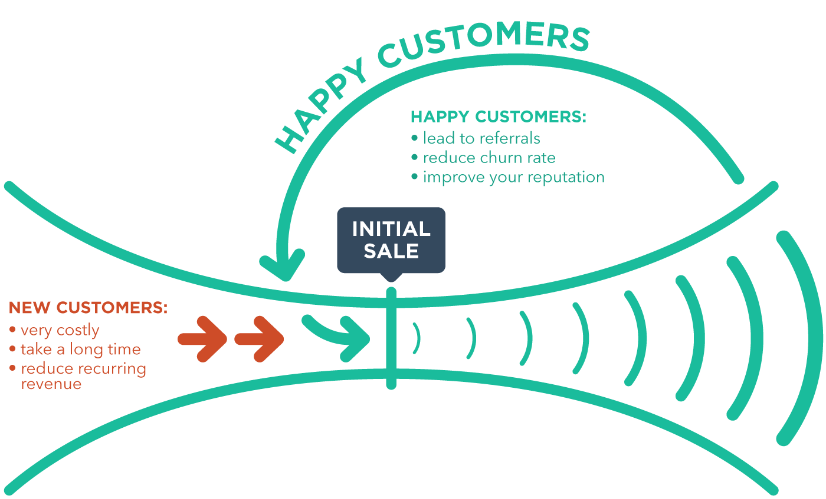
The Problem & The Goal
Poorly stocked inventory can cause poor customer experience.
Causes increased churn rates and loss in profits.
Production efficiency is limited by the lack of knowledge on product performance.
Goal: Provide a visual analysis of the data and generate a predictive model that can forecast sales

Slide 3
The Clients
The model will provide a reliable method for the client to forecast the performance of their products for up to a month
Individual Retail Stores:
Knowledge of popular items allows for retail stores to constantly update their shelves with the best products to potentially bring in larger profit margins
Managers will also be able to reliably predict efflux of each product which will help maintain properly stocked inventory
Corporate Retail Stores:
Will utilize the model for the same purposes as individual retail stores
However, poor customer experience here will have a larger effect as it affects customer loyalty and reception of corporate reliability
Production Companies:
Can help prioritize the manufacturing process to focus efforts on items of higher sale value.
If expanded with geographical information, production companies can extend their sales to better performing areas

Slide 4
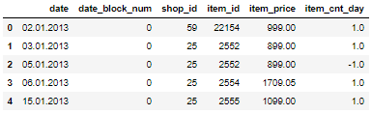
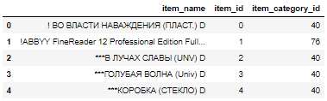
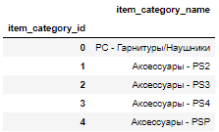
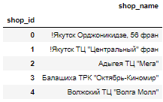
The Data
Figure 1. Quick look at provided training dataset
The training data consisted of 6 variables and nearly 3 million data entries ranging from Jan. 2013 to Oct. 2015.
The original date format was DD.MM.YYYY.
The items data consisted of information on 22,170 different items along with their appropriate item categories.
The item categories data and shops data each had 84 and 60 entries respectively.
Figure 2. Quick look at provided items dataset
Figure 3. Quick look at provided item categories dataset
Figure 4. Quick look at provided shops dataset

Slide 5
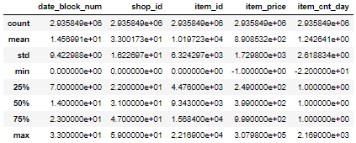


The Cleanup
The string format of the date column was changed to a function friendly format (DD.MM.YYYY -> YYYY-MM-DD) for conversion to datetime objects.
There were two extreme values in the item_price variable that do not make practical sense and were removed from the dataset.
There was an outlier on the higher price spectrum at 307,980 which is magnitudes than the second greatest at 59,200.
There was also single negative outlier at -1.
There were also 7300 entries that have negative values in the item_cnt_day variable which could represent returns to a store. However, because no additional information regarding the data could be gathered, I chose not to remove them.
Figure 6. Note the positive and negative outliers in the item_price column
Figure 5. String format conversion to date parseable format

Slide 6
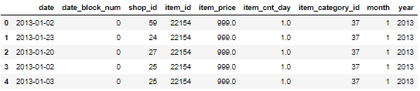
The Transformation
The name columns in the three datasets (items, shops, and item categories) had a mix of Russian and English.
Not time efficient to extract only the English characters.
Costly to translate the Russian characters.
Decided to remove the names from my analysis
Valid choice as each item, shop, and item category had a unique ID.
As a result, only the item dataset needed to be merged with the training dataset (for the unique item category IDs).
Additional month and year columns were constructed from the date column for use as categorical variables.
Figure 7. Transformed training data with all the necessary variables for exploratory data analysis.

Slide 7
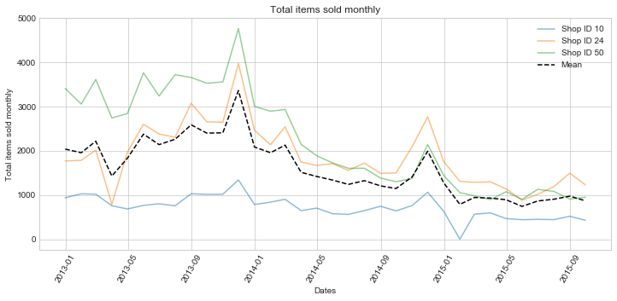
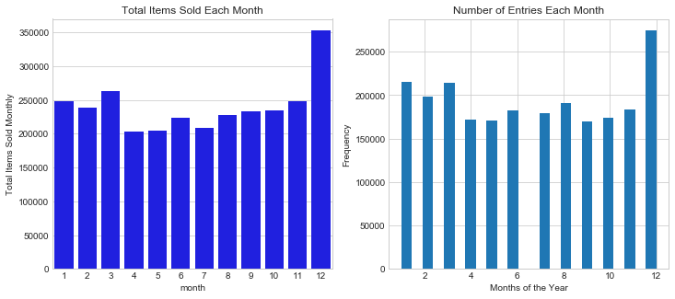
The Trends
Time-series line plot of 3 randomly selected shops from January 2013 to October 2015 show a general decline in sales over the years (2013 > 2014 > 2015).
Additionally, there is a visible peak on December of 2013 and 2014 which may due to some sort of cyclical trend.
Applied a combination of a histogram and a barplot to emphasize the cyclical trends
There are increased number of entries and total sales in December for years 2013 and 2014.
Figure 8. The time-series plot shows an apparent decline in overall sales over time.
Figure 9. The histogram and bar plot of data from 2013 and 2014 show increased total entries and total sales during the month of December.

Slide 8
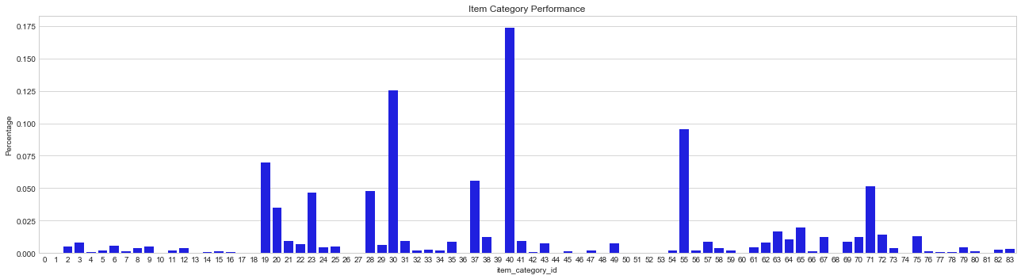
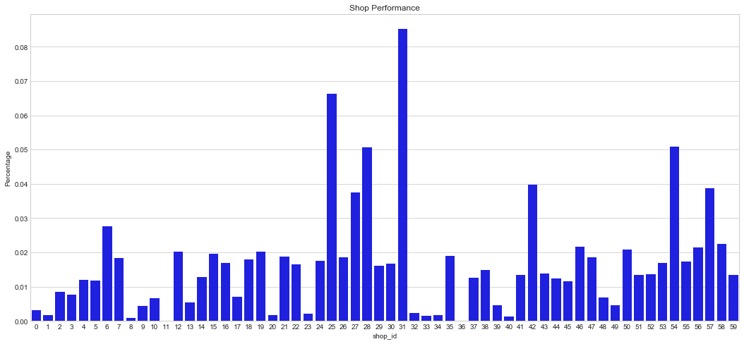
The Statistics
In order to make the development and deployment of the model more computationally feasible, groups were made for originally just item category IDs, shop IDs, and later item IDs.
17 Groups for Item Categories IDs
13 Groups for Shop IDs
24 Groups for Item IDs
Groups were statistically validated to be different from each other via two-sample t-test with p-value 0.05.
Figure 10. The normalized bar plot shows performance of shops relative to each other.
Figure 11. The normalized bar plot of item categories shows relative performance.

Slide 9
The Model
Simple Linear Regression model Using 4 Variables:
Item Category IDs: Both the grouped and independent versions of the Item Category IDs were used in the development of the model
Shop IDs: Both the grouped and independent versions of the shop IDs were used in the development of the model
Month & Year: Categorical representations of the previous date variable used in the time-series plot
Initial deployment of the model performed poorly. As a result, different combinations of the variables (besides Month & Year) were attempted.
In total, there were 5 tested and deployed models.

Slide 10
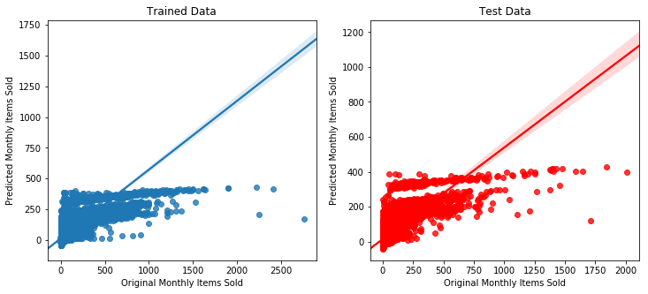
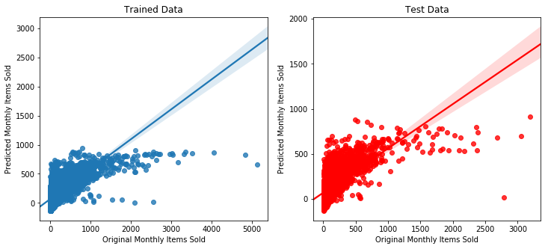
The Results
Model 1, 3, 4, 5:
Predictions consistently underestimate the actual values.
Irregular max predicted value cutoff not reflected in actual values
Contains negative predicted values along with a right skew in predictions
Model 2:
Similar trends to all other models
Model 2 does not have the irregular max predicted value cutoff in the predictions for the split test data
Figure 12. Regression plot of model 1
Figure 13. Regression plot of model 2

Slide 11
The Scores
Variables used in each model. *Note: All models used manually inputted values for month and year to reflect Nov. 2015
Model 1: Grouped Shop ID and Grouped Item Category ID
Model 2: Shop IDs and Grouped Item Category ID
Model 3: Shop IDs and Item Category IDs
Model 4: Shop IDs and Grouped Item IDs
Model 5: Shop IDs and Group Item IDs. Averaged the data across the months and removed the year
Model: | Changed Variable: | Generated RMSE: | Kaggle RMSE:
1 | Grouped Shop ID and Item Category ID | 426.39 | 1198.72
2 | Scrapped Shop ID | 154.30 | 243.86
3 | Scrapped Item Category ID | 90.17 | 260.18
4 | Shop IDs and Grouped Item IDs | 60.45 | 152.59
5 | Averaged Data and removed year variable | 47.46 | 161.70
Figure 14. All models trained and deployed along with their respective scores. Also notes the variable changes from the immediately previous model.

